Slide 1

Mini Explorer
A mobile environment sensor
By Duc Nguyen and Jordan Pulido

Slide 2
I. General Information
1. Mission
A moving device that can be controlled from afar
Display real-time environmental readings
2. Mechanism
- The Raspberry Pi car will use the sensor to read environment data and send to database
The app retrieves readings from database
Users can control the car by Bluetooth

Slide 3
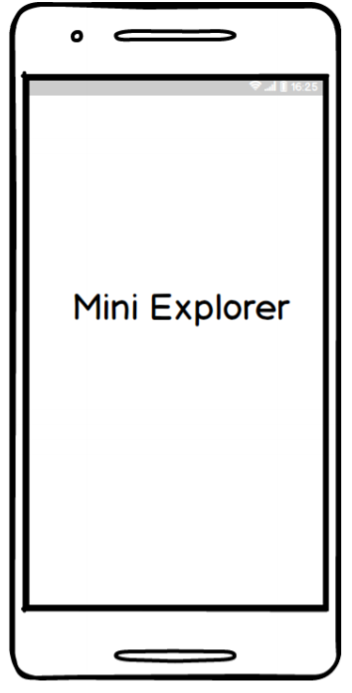
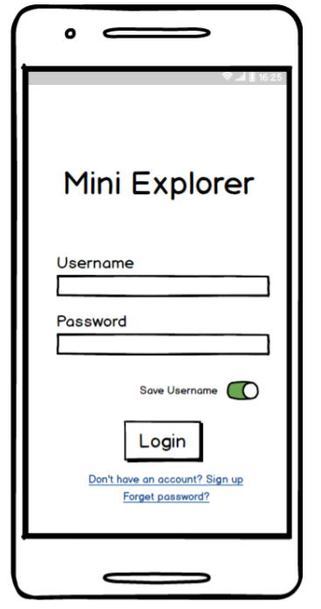
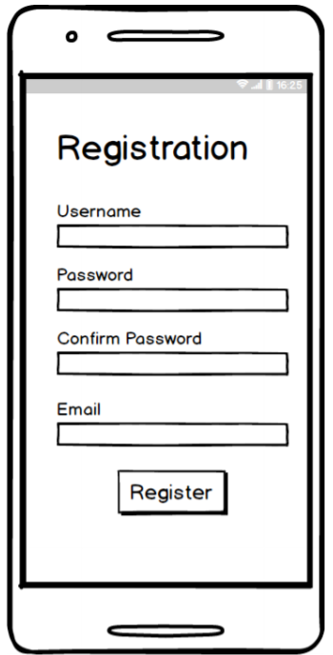
II. App Information
1. Screen Mockups

Slide 4
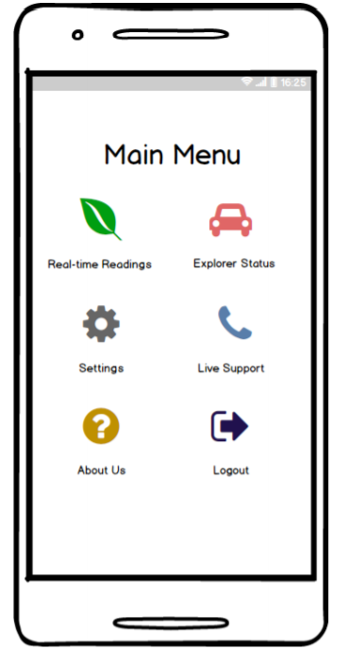
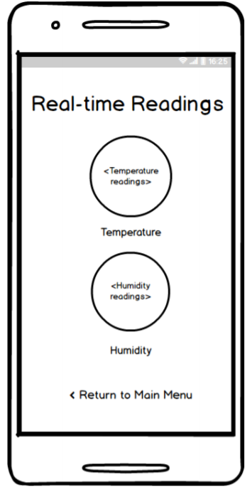
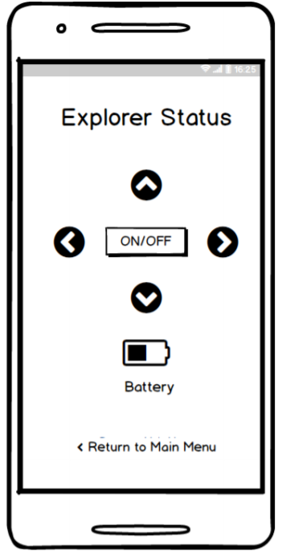
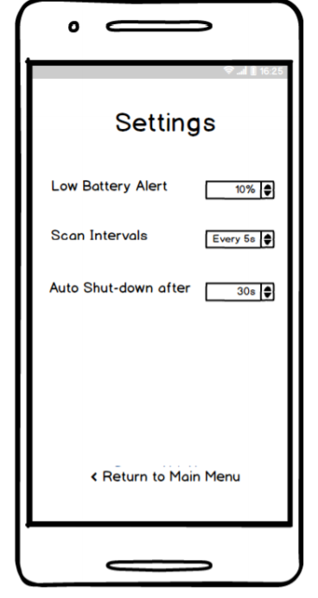

Slide 5
2. Demonstration

Slide 6
3. What’s next?
Improve the UI
Create database with Firebase
Retrieve real-time readings from online sources

Slide 7
4. Test plan
Register account and have the credentials stored on database
Successfully retrieve real-time environment readings from online sources
App will not allow users to enter the app if credentials are invalid

Slide 8
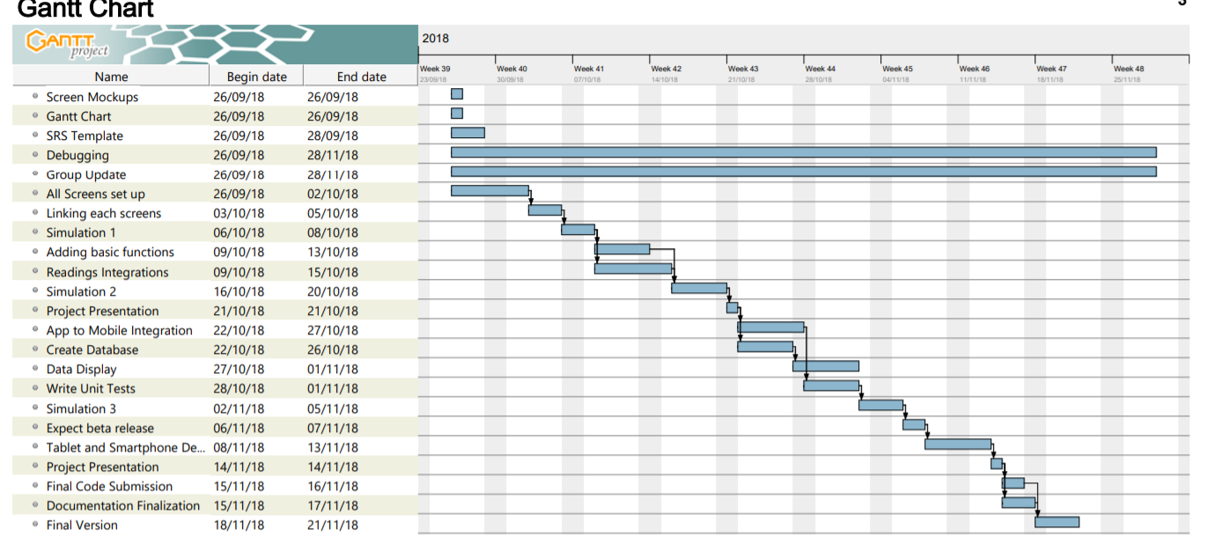
5. Gantt Chart

Slide 9
6. Contribution
Duc Nguyen – Main Idea, Gantt Chart, Main Menu Screens
Jordan Pulido – SRS Documentation, Registration Screen, Login Screen
Github: https://github.com/ngtrangminhduc/MiniExplorer

